Slide 1
GSA’s Vendor and Customer Self Service (VCSS)
Notes:
Hello and welcome to GSA’s Vendor and Customer Self Service (VCSS) training course. This course has been developed to walk you through the navigation and functionality of VCSS. You are listening to Segment 1, Introduction

Slide 2

Correspondence Overview
Correspondence
Correspondence is your way of communicating to GSA general issues or questions about your account, or a specific statement, payment, or refund on your account.
Correspondence is not email.
You or another person (on your account) can create correspondence to send to GSA.
GSA can send correspondence to your account for your review.
It is important to understand that there are several types of correspondence that can be sent, including:
Statement correspondence, which are messages regarding a specific statement.
Account correspondence, which are messages regarding a general issue or question regarding your account and not related to a specific statement, payment, or refund.
Payment correspondence, which are messages regarding a specific payment.
Refund correspondence, which are messages regarding a specific refund.
Payment and refund correspondence have already been covered in the payment section of this presentation. They are not available in the Correspondence menu.
G1
Notes:
It is important to understand that there are several types of correspondence that can be sent:
Payment Correspondence – this was already covered in the payments section. If you need to send correspondence to GSA regarding a specific payment, you must access the Payments menu bar, open the payment record, and send the correspondence.
Refund Correspondence – this was also already covered in the payments section. If you need to send correspondence to GSA regarding a specific refund, you must access the Payments menu bar, open the refund record, and send the correspondence.
Account Correspondence – messages regarding general issues or questions with your account. These messages are not related to a specific payment, refund or statement on your account.
Statement Correspondence – a message regarding a specific statement on your account. These messages are not related to a specific payment or refund on your account.

Slide 3
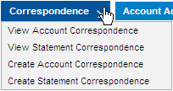
Correspondence Menu
View Account or Statement Correspondence
Select the View Account Correspondence option to search for and view account correspondence.
Select the View Statement Correspondence option to search for and view correspondence for a specific statement on your account.
Create Account or Statement Correspondence
Select the Create Account Correspondence option to create account correspondence.
Select the Create Statement Correspondence option to create correspondence for a specific statement on your account.
G2
Notes:
If you need to create or review correspondence, access the Correspondence menu bar options:
View Account Correspondence menu option goes to the Review Correspondence page where you can search for and view correspondence related to your account.
View Statement Correspondence menu option goes to an Enter Statement Number page where you enter a Statement Number, and then you can search for and view correspondence related to that statement.
Create Account Correspondence menu option goes to the Send Correspondence page where you can enter correspondence to send to GSA regarding your account.
Create Statement Correspondence menu option goes to the Enter Statement Number page where you enter a Statement Number, and then you can send correspondence related to that statement.
We are now going to walk through each of these Correspondence options in this section.

Slide 4
View Correspondence
The Review Correspondence page is used to view account or statement correspondence.
View correspondence.
Account correspondence are messages regarding a general issue or question regarding your account.
Statement correspondence are messages regarding a specific statement on your account.
If you are reviewing statement correspondence, there is an extra step to identify the statement you want to view the correspondence for.
View the details of each correspondence record, including:
The name of the person that created the correspondence
The date the correspondence was created.
Message text.
Also, create account or statement correspondence to send to GSA.
G3
Notes:
Review Correspondence is used to search for and view account or statement correspondence.

Slide 5


View Correspondence (Cont’d)
View Account Correspondence
To access the Review Correspondence page to view account correspondence, from the menu bar select Correspondence > View Account Correspondence.
View Statement Correspondence
To access the Review Correspondence page to view statement correspondence, from the menu bar select Correspondence > View Statement Correspondence.
G4
Notes:
Access the Review Correspondence page from the menu bar.

Slide 6
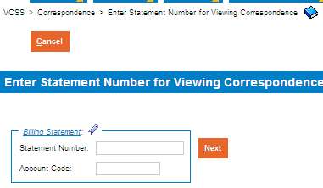
View Correspondence (Cont’d)
If you selected the View Statement Correspondence menu option, the Enter Statement Number page displays.
Identify the statement you would like to view correspondence for by entering the Statement Number and selecting the [Next] button.
If the statement is associated with more than one account, you must also enter the Account Code.
G5
Notes:
The Enter Statement Number page displays, where you identify the statement you want to review correspondence for.
If you selected the View Account Correspondence option, you will not see this page.

Slide 7
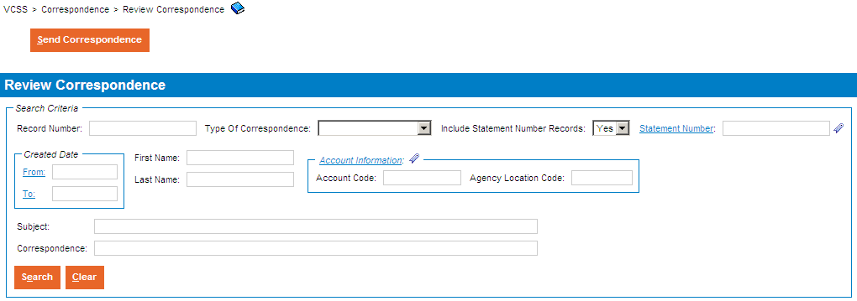
View Correspondence (Cont’d)
Review Correspondence page
The Review Correspondence page displays after you do either of the following:
Select the View Account Correspondence menu option.
Select the View Statement Correspondence menu option, then identify the statement number you would like to view correspondence for.
Enter search criteria and select the [Search] button.
Note that from this page, you can also select the [Send Correspondence] button to send a new message.
G6
Notes:
The Review Correspondence search page displays where you can search for correspondence associated with the statement you identified on the previous page.
If you selected View Account Correspondence from the menu bar, you will also be taken to this same page. The only difference is the search is filtered according to a statement you identify or your account.

Slide 8
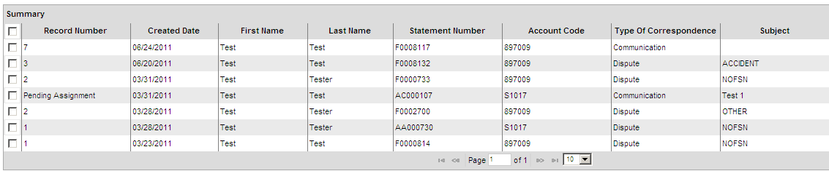
View Correspondence (Cont’d)
Review Correspondence page
In the search results, review the correspondence records.
G7

Slide 9
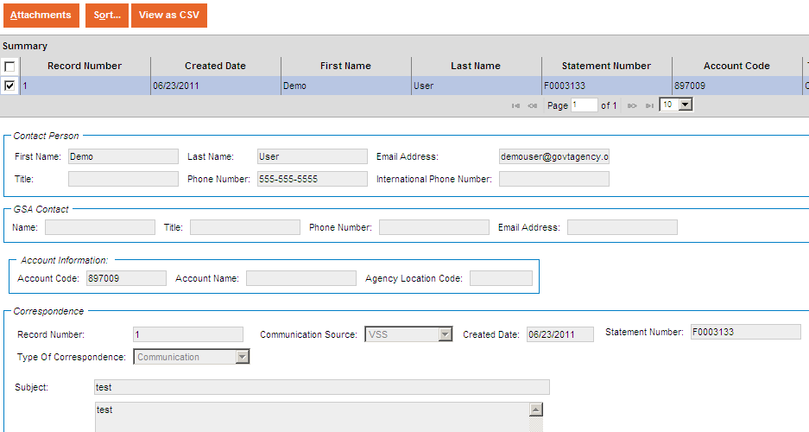
View Correspondence (Cont’d)
Correspondence Record
To review the details of a correspondence record, select the correspondence record and then review the details that display below the search results.
G8
Notes:
To review details for an account correspondence record, select the record and review the details.
D

Slide 10
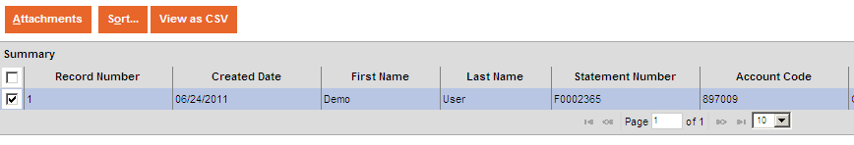
View Correspondence (Cont’d)
Review Correspondence page
To view attachments associated with a correspondence record, select a correspondence record and then select the [Attachments] button.
Scrolling to the right of the search results will show the “Has Attachments” column, which identifies if an attachment is present.
G9
Notes:
To review attachments associated with an account correspondence record, select the [Attachments] button.

Slide 11
Create Correspondence
The Send Correspondence page is used to create account or statement correspondence to send to GSA.
Create correspondence.
Account correspondence are messages regarding a general issue or question regarding your account.
Statement correspondence are messages regarding a specific statement on your account.
If you are creating statement correspondence, there is an extra step to identify the statement you want to create the correspondence for.
If you have access to more than one account, there is an additional step to identify which account you are creating the correspondence for.
G10
Notes:
Create correspondence to send to GSA regarding a general issue or question with your account, or a specific statement on your account.

Slide 12


Create Correspondence (Cont’d)
Create Account Correspondence
To access the Send Correspondence page to create account correspondence, from the menu bar select Correspondence > Create Account Correspondence.
Create Statement Correspondence
To access the Send Correspondence page to create statement correspondence, from the menu bar select Correspondence > Create Statement Correspondence.
G11
Notes:
Access the Send Correspondence page from the menu bar.

Slide 13
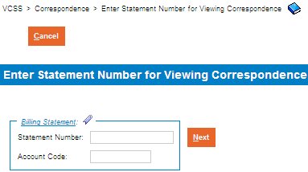
Create Correspondence (Cont’d)
If you selected the Create Statement Correspondence menu option, the Enter Statement Number page displays.
Identify the statement you would like to create correspondence for by entering the Statement Number and selecting the [Next] button.
If the statement is associated with more than one account, you must enter the Account Code.
G12
Notes:
The Enter Statement Number page displays, where you identify the statement you want to create correspondence for.
If you selected the Create Account Correspondence option, you will not see this page.

Slide 14
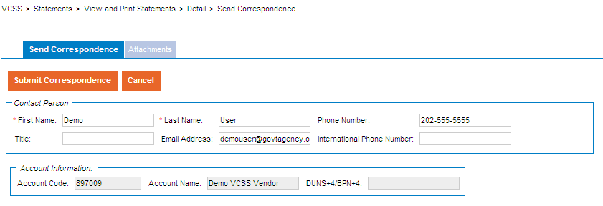
Create Correspondence (Cont’d)
Send Correspondence page
The Send Correspondence page displays after you do either of the following:
Select the Create Account Correspondence menu option.
Select the Create Statement Correspondence menu option, then identify the statement number you would like to create correspondence for.
Enter your contact and account information.
G13
Notes:
The Send Correspondence page displays where you can enter account correspondence information.

Slide 15
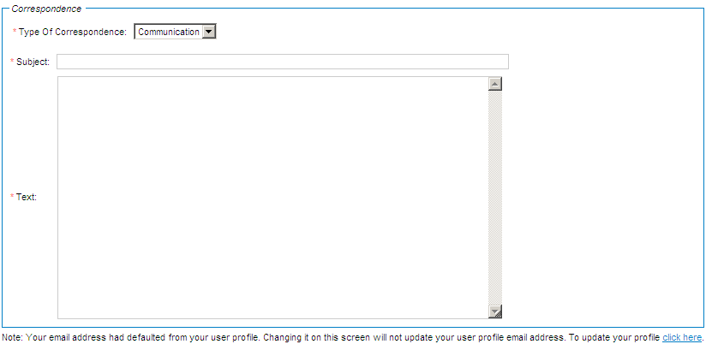
Create Correspondence (Cont’d)
Send Correspondence page
Enter your correspondence information.
G14
Notes:
Review the correspondence information.

Slide 16
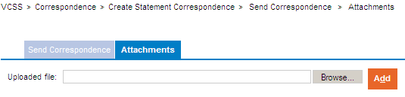
Create Correspondence (Cont’d)
Add an Attachment to the Correspondence
If you would like to add supporting documentation to your correspondence, select the Attachments tab and then select the [Browse] button to search for a file on your computer.
G15
Notes:
If you would like to add supporting documentation to your correspondence to GSA regarding your account, select the Attachments tab.

Slide 17
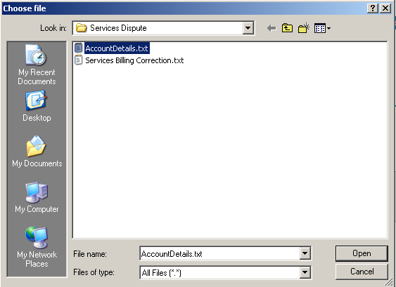
Create Correspondence (Cont’d)
Add an Attachment to the Correspondence
In the choose file pop-up window, locate the file on your computer, select the file, and then select the [Open] button.
G16
Notes:
Search for and select the file on your computer.

Slide 18
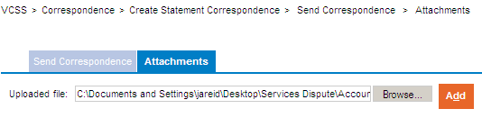
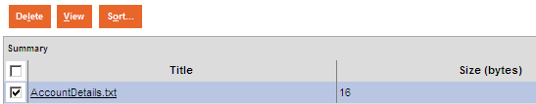
Create Correspondence (Cont’d)
Add an Attachment to the Correspondence
Confirm that the Uploaded file path displays, and then select the [Add] button to add this attachment.
If the attachment is successfully added, the attachment record displays in the attachments summary below.
If you would like to view the attachment, select the attachment record and then select the [View] button.
G17
Notes:
You need to make sure to actually add the attachment by clicking the [Add] button.

Slide 19
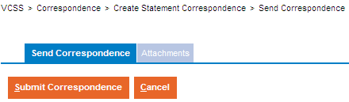
Create Correspondence (Cont’d)
Send Correspondence page
Select the Send Correspondence tab to return to the message information (if you did not add an attachment you will already be in the Send Correspondence tab).
Select the [Submit Correspondence] button to send this correspondence to GSA. Once submitted, GSA will receive and review this correspondence.
G18
Notes:
Make sure to go back to the Send Correspondence tab in order to access the [Submit Correspondence] button.

